Slide 1
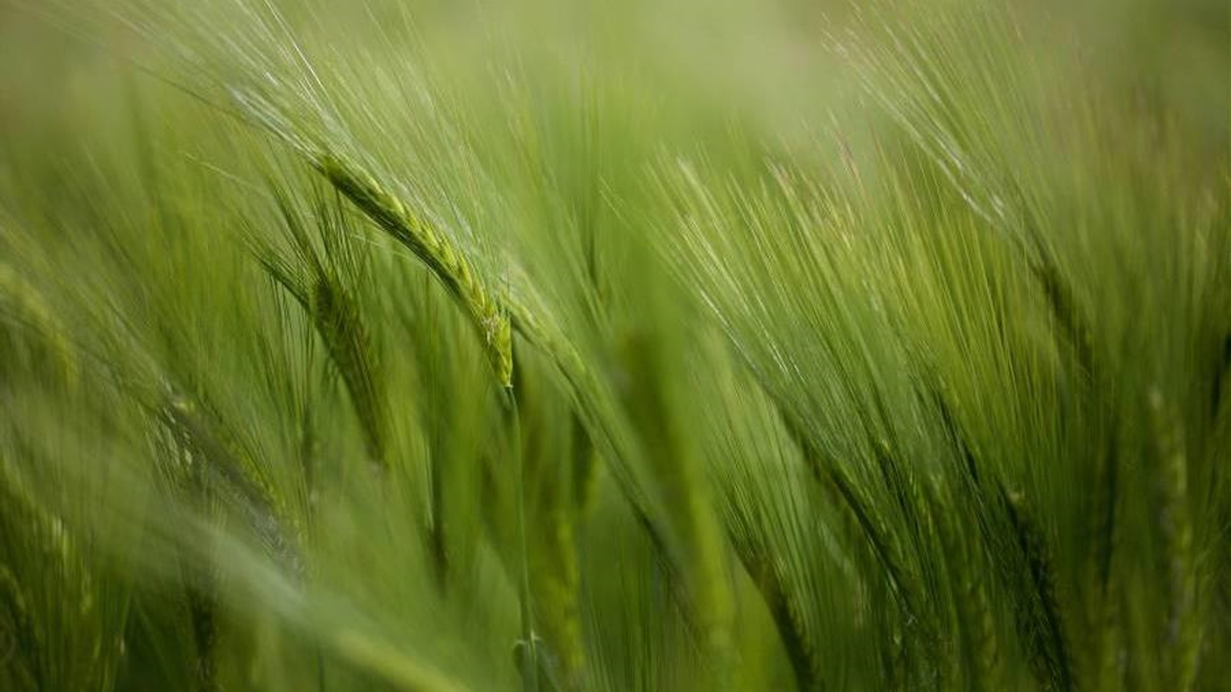
eau Claire county FARMLAND PRESERVATION Plan Update eau Claire County Towns Association Unit Meeting Thursday, April 30, 2026

Slide 2
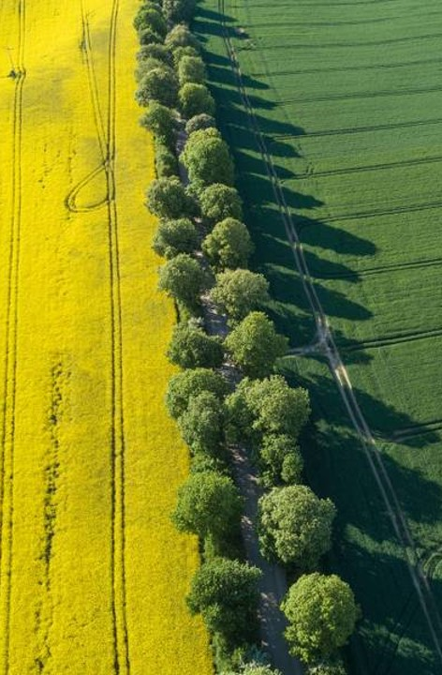
Planning Timeline
Project initiated October 2023
Farmland Preservation Plan (FPP) Update Steering Committee met 2023 – 2025.
County Board approved resolution 25-26/068 on 10/21/2025 adopting a Public Participation Plan.
County Board Chair formed Comprehensive Plan Steering Committee (CPSC) on 11/5/2025.

Slide 3
Planning Timeline con’t
CPSC met 12/5/2025 – 2/27/2026 (5 meetings) to review draft plan along with solicited comments from the public.
Joint Land Conservation Commission and & CPSC meeting 3/16/2026 to review the draft FPP
Preliminary FPP review by the Department of Agriculture Trade and Consumer Protection (DATCP)
Draft FPP informational meeting 4/15/2026
Towns Association Meeting 4/30/2026

Slide 4
Why do we need a farmland preservation plan?
Farmland Preservation Program
Wis. Stat. Chapter 91
Farmland Preservation Plan
Farmland Preservation Planning
Farmland Preservation Zoning
Land Use Division - Title 18
Admin. Rule ATCP 49
Farmland Preservation Tax Credits
LCD
DATCP
Align w/Comp Plan
Agricultural Enterprise Area (AEA)
Conservation Compliance
Resources
DATCP Home Farmland Preservation Program
Farmland Preservation Program | Land Conservation Division

Slide 5
2026 farmland preservation plan summary
Comprised of 6 Chapters:
Chapter 1 – Background
Chapter 2 – Farmland Preservation Goals, Objectives and Policies
Chapter 3 – Farmland Preservation Areas – Mapping
Chapter 4 – Preservation Strategies and Summary of Goals, Objectives and Actions
Chapter 5 – Consistency with Other Local Plans
Chapter 6 – Existing Conditions

Slide 6
Plan Goals
Natural Resource Goal – Page 7
Preserve and protect the most valuable resources for current and future residents of Eau Claire County, including: productive forests, farmland, environmentally sensitive areas, and wildlife habitat as the foundations of our rural landscape.
Land Use Goal – Page 28
Protect farmland from developments that are not an “Agricultural use” as defined by Wis. Statutes §§ 91.01(2)(a) & (b) or an “Agricultural-Related use” as defined by Wis Statutes §§ 91.01(3)(a) & (b) in order to ensure the preservation of farmland for future generations, while minimizing land use conflicts between agricultural and nonagricultural uses and avoiding fragmentation of agricultural land. Anything contained in the foregoing definitions notwithstanding, it is the goal and objective of Eau Claire County to prohibit construction of commercial wind and solar on A-P-zoned property.

Slide 7
Plan Goals…cont. WI stat. 91.01(2)(A) & (B) & Wi stat. 91.01(3)(a) & (B)
Land Use Goal – Page 28
(2) “Agricultural use” means any of the following:
(a) Any of the following activities conducted for the purpose of producing an income or livelihood:
1. Crop or forage production.
2. Keeping livestock.
3. Beekeeping.
4. Nursery, sod, or Christmas tree production.
4m. Floriculture.
5. Aquaculture.
6. Fur farming.
7. Forest management.
8. Enrolling land in a federal agricultural commodity payment program or a federal or state agricultural land conservation payment program.
(b) Any other use that the department, by rule, identifies as an agricultural use.
(3) “Agriculture-related use” means any of the following:
(a) An agricultural equipment dealership, facility providing agricultural supplies, facility for storing or processing agricultural products, or facility for processing agricultural wastes.
(b) Any other use that the department, by rule, identifies as an agriculture-related use.

Slide 8
Farmland preservation Plan Map
Know your material in advance
Anticipate common questions
Rehearse your responses
Maintaining composure during the Q&A session is essential for projecting confidence and authority. Consider the following tips for staying composed:
Stay calm
Actively listen
Pause and reflect
Maintain eye contact

Slide 9

What’s next?
30 Day Public Hearing notice to (May 2026):
ECC towns, villages and cities
Neighboring counties
WI Department of Administration
West Central WI Reginal Planning
DATCP
Towns and municipalities may request additional presentations by county staff.
Public Hearing on the proposed draft by the Planning & Development Committee – June 2026
First and second reading of the FPP by the Eau Claire County Board in July/August 2026
Final plan certification by the Department of Agriculture, Trade and Consumer Protection (DATCP) in September 2026

Slide 10
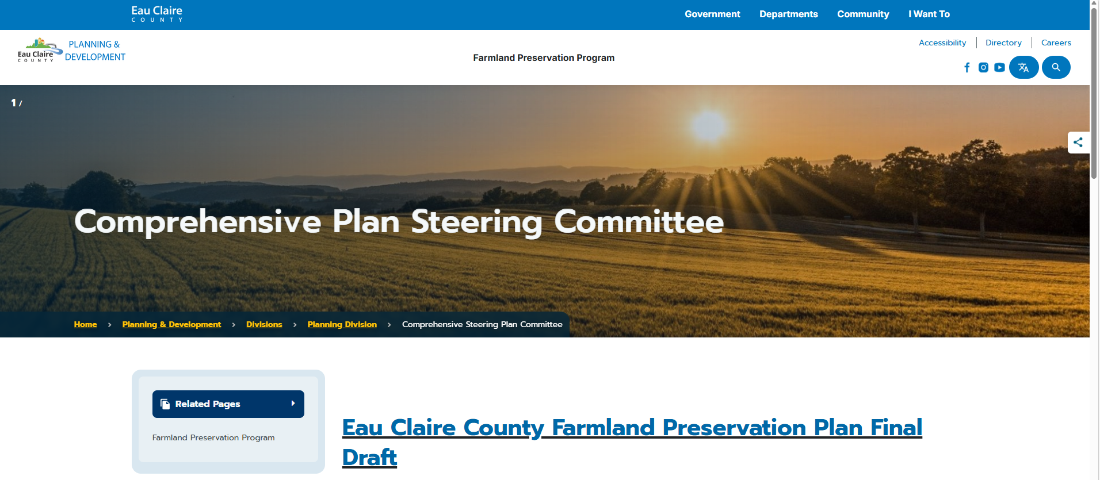
Resource PAGE
Here’s the web page link to the Comprehensive Plan Steering Committee
Access to the proposed draft FPP, agendas, agenda packets, minutes, correspondences received, etc.

Slide 11

Thank you & Q & A
Staff
Rod Eslinger – Director of P&D
Chad Berge – Land Conservation Manager
Matt Michels – Senior Planner
Tim Wucherer – Agronomist
Richard Eaton – Assistant Corporation Counsel

